Slide 1

Sentiment Analysis of Customer Tweets: Gaining Competitive Insights for Google and Apple Products
NLP

Slide 2
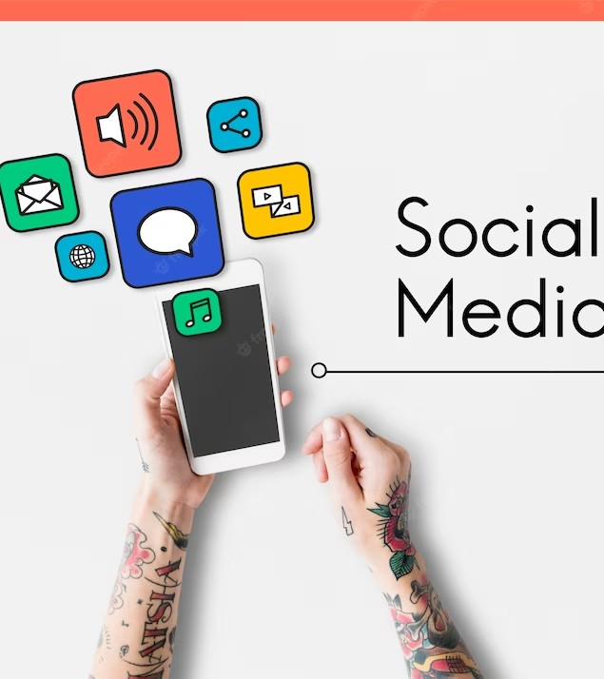
BUSINESS UNDERSTANDING
Uncover the emotions behind Google and Apple products by analyzing tweets. Discover how people feel about these brands and their products to help stakeholders understand areas of improvement to enhance customer satisfaction and Loyalty!

Slide 3
OBJECTIVES
To build a specialized sentiment analysis model that can analyze twitter sentiments of google and apple products
To establish if there is any differences in twitter sentiments between apple and google product
To find out the inclusive sentiment view towards apple an google products from twitter
To investigate the recurring topics of interest associated with negative or positive sentiments as seen by google and apple brands

Slide 4
DATA UNDERSTANDING
The dataset used in this project, sourced from https://data.world/crowdflower/brands-and-product-emotions, consists of 3 columns and 9093 rows. The columns include;
tweet_text : contains the text of tweets.
emotion_in_tweet_is_directed_at : column provides insights into the emotions expressed.
is_there_an_emotion_directed_at_a_brand_or_product : indicates the brand/product the emotion is directed at.

Slide 5
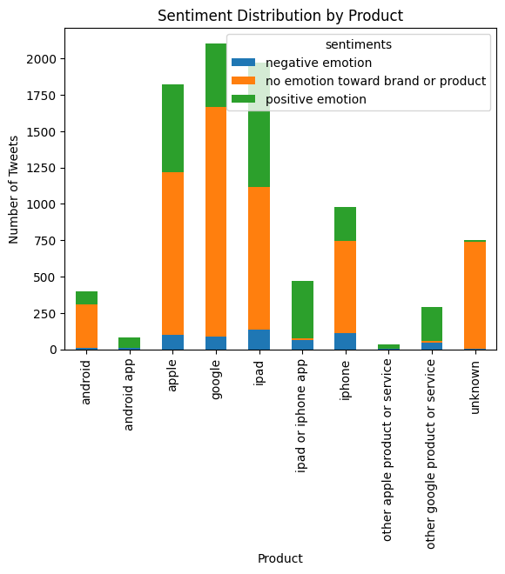
EXPLARATORY DATA ANALYSIS

Slide 6
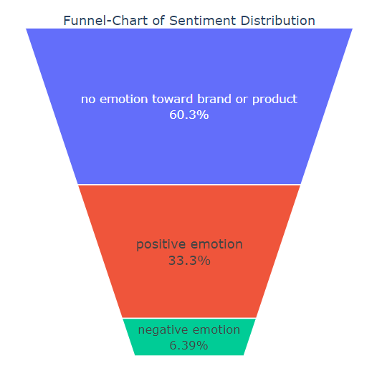

Slide 7
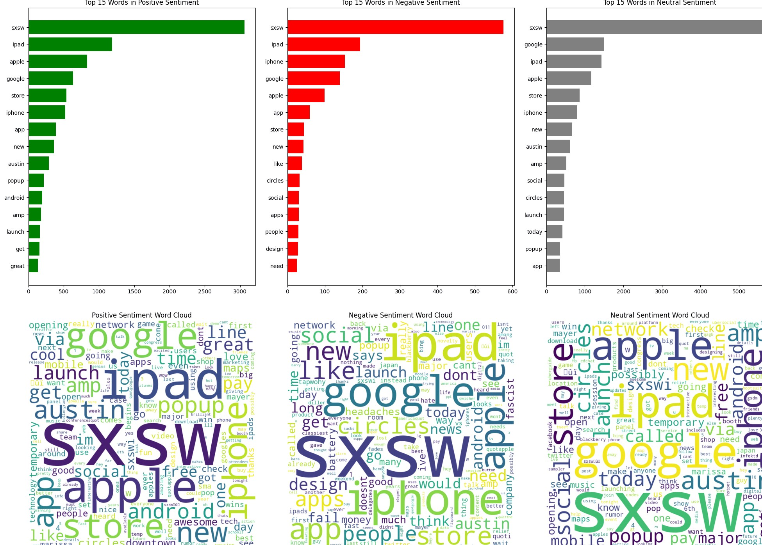
Word Frequency

Slide 8

MODELLING
Naive Bayes
Accuracy of 87% on training set and 77% on the test dataset
Random Forest
Accuracy score of 98% on training set and 86% on test.
SVM
Accuracy of 96% on training set and 87% on the test dataset
Neural Network
Accuracy score of 83% on test set

Slide 9
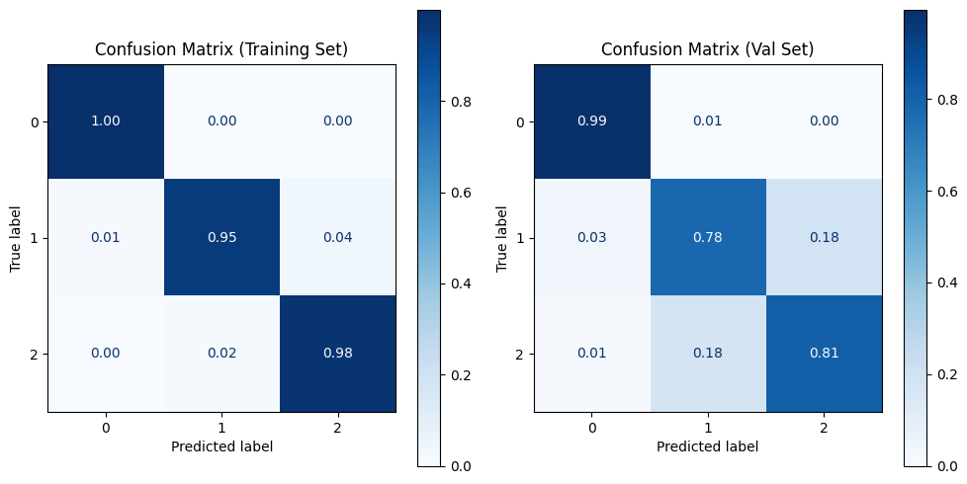
Final Model - Random Forest
Our tuned Random Forest classifier performed pretty well with an accuracy of 98% on training and 86% on the test set.

Slide 10
CONCLUSION
Our analysis revealed varying degrees of positivity and negativity in the Twitter discussions concerning their products, shedding light on the overall inclusive sentiment view towards both brands. Additionally, by investigating recurring topics associated with positive and negative sentiments using a word cloud for each sentiment, we gained valuable insights into the prevailing themes that influence public perception of Google and Apple. This research contributes to a deeper comprehension of how sentiments and topics converge to shape the online discourse surrounding these companies, offering a valuable resource for both academia and industry..

Slide 11
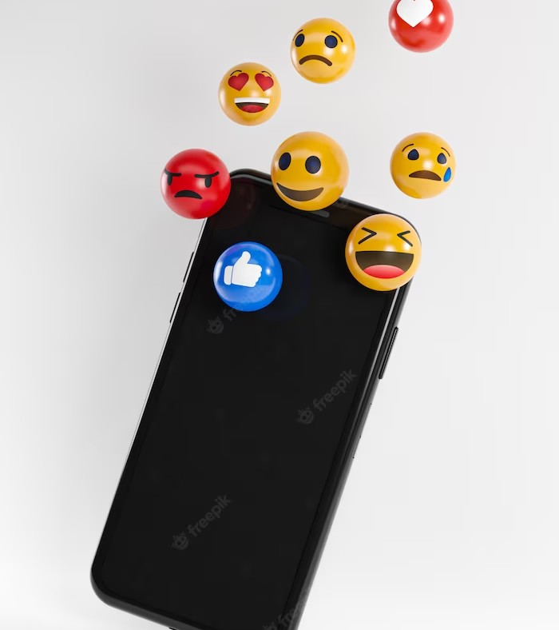
RECOMMENDATIONS
Craft marketing messages that align with the predominant sentiments expressed by consumers.
Collaborate with influencers who align with the positive sentiments around your brand.
Regularly assess the impact of your marketing strategies on sentiment trends. Track changes in sentiment over time to gauge the effectiveness of your efforts and make data-driven adjustments

Slide 12

NEXT STEPS
Incorporate more advanced natural language processing techniques and machine learning algorithms to enhance the accuracy of sentiment classification
Extend the analysis over a longer time period to observe trends and changes in sentiment over time
Analyse sentiment based on user demographics such as age, gender, and location.
Develop predictive models to anticipate shifts in sentiment

Slide 13
Thanks!

